Slide 1
Abaqus Python
Abaqus Python Scripting
Learn with the concepts
Lec 10 – Create a Model

Slide 2





Share
Share
Subscribe
Like
Subscribe
Like
Comment
Comment
Download files used in this lecture:
Python Script
Data file
ODB file
Explanation ppt
https://github.com/Abaqus-Python/Lec10_Create-A-Model

Slide 3
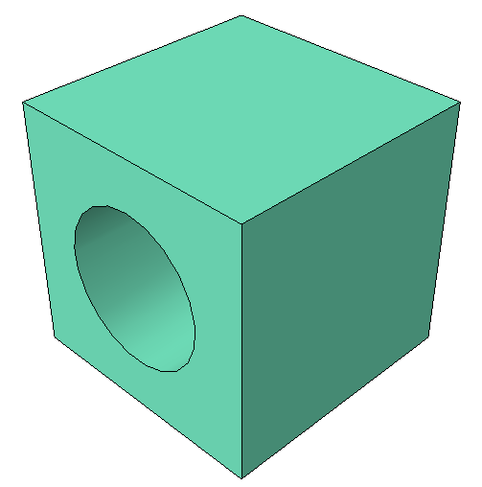
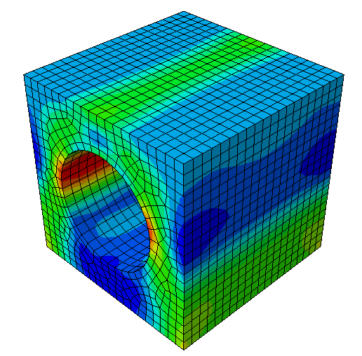




Create a Model:
Model
Results
$$p$$
6mm
20mm
20mm
20mm

Slide 4
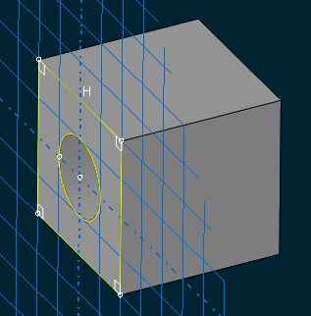





Create a Model:
$$σ$$
$$ε$$
Part
Material Properties
Assembly
Static
Dynamic
Visco
Coupled
Define Analysis
Loads and BC
Mesh

